Slide 1
NIRMANN 2023
SMART CITY INNOVATION

Slide 2



Meet The Team
Harshit Singh
Btech CSE 2ND Year
Aum Patel
Btech CSE 2ND Year
Akash Raj Patel
Btech CSE 2ND Year

Slide 3

PROBLEM STATEMENT
“ The challenge is to develop a web application for 3d data rendering “

Slide 4
OBJECTIVES
“To read the ArcGIS.Shp file of the area of kviy and develop an api that will allow the data to be loaded on the web in 2-d and 3-d, using height of the building as the third dimension.”

Slide 5


Libraries We’re Using
PyVista - a Python library for processing and handling (.sbx and .shx) files.
Flask - a Python web framework as a communication layer between backend (python) and frontend (html/css).
Geopandas – Python library for reading and extracting attributes from .shp files.

Slide 6
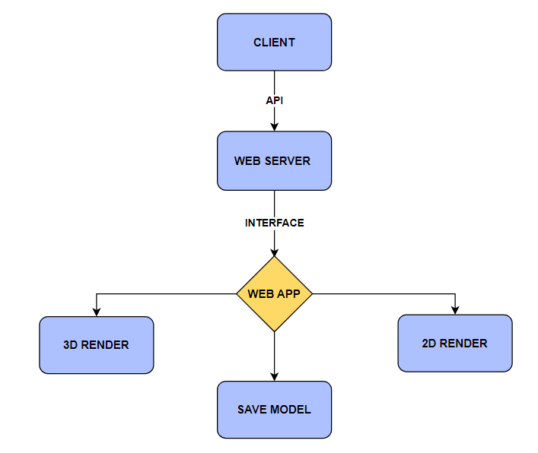
Application FLOW

Slide 7
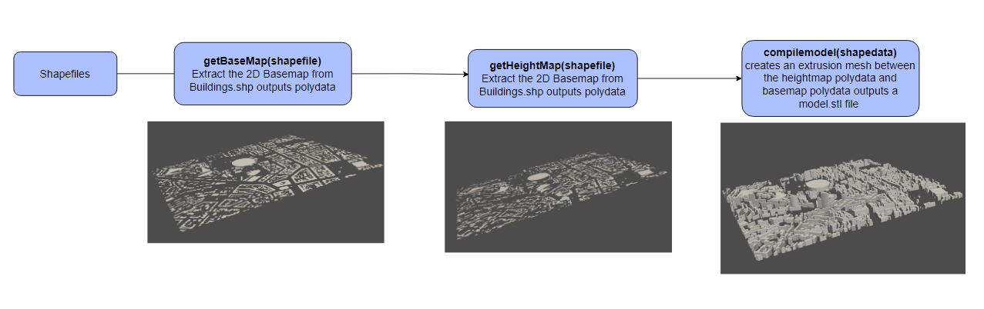
Application Working

Slide 8
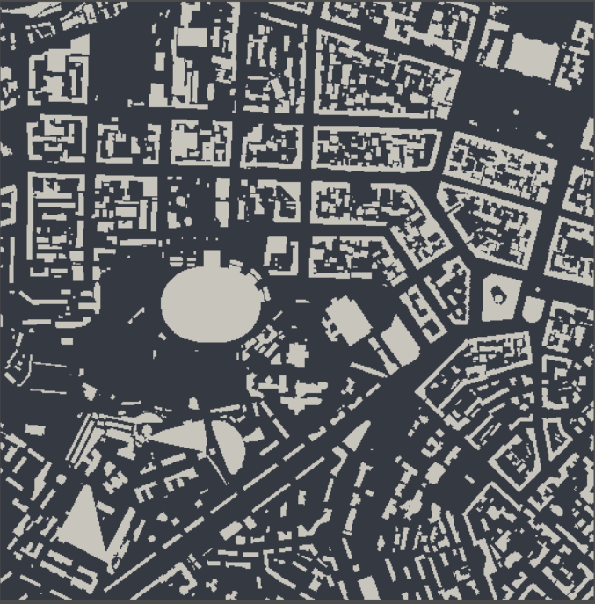
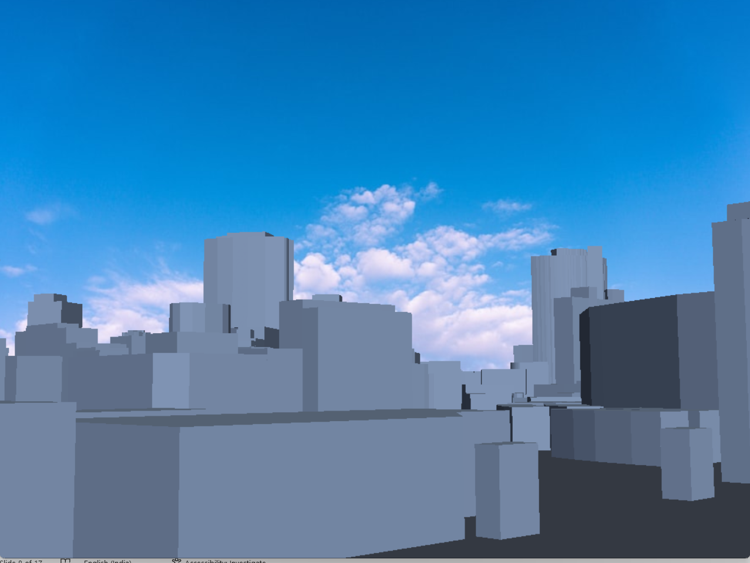
Final Results

Slide 9
Achievements
3d renderer Made fully in python
Fully working API calls that can convert 2d models to 3d
Webapp to view both models
3D model supports pan, zoom, pivot
Simple and intuitive controls.

Slide 10
Target Audience
Government
Government agencies can run several risk analysis on the model to check the viability of construction projects.
Private Construction Agencies
Can use it to demonstrate their construction projects in an interactive way.
Travel And Tourism Agencies
Travel and tourism agencies can use it to entice travel demands in particular cities.
Research Agencies
To simulate the affect of hypothetical, government policies, etc.

Slide 11
Monetization
Freemium Model: Offer a basic version of the 3D city map viewer for free, but charge for advanced features, such as high-resolution images, 3D printing, or data analysis tools.
Subscription Model: Offer a monthly or yearly subscription that provides access to premium features of the 3D city map viewer, such as real-time traffic information, historical data, or point of interest details.

Slide 12
Monetization
Advertisements Model: Offer a free version of the 3D city map viewer that includes advertisements to generate revenue. Advertisements could be targeted to specific audiences based on location or demographics.
Enterprise Model: Offer an enterprise version of the 3D city map viewer that includes customized features for specific industries, such as real estate, urban planning, or transportation. Charge businesses a one-time or recurring fee for access to these features.

Slide 13
Monetization
Partnership Model: Partner with other companies or organizations to integrate their products or services with the 3D city map viewer. Charge a commission or a percentage of the revenue generated from these partnerships.
Licensing Model: License the technology behind the 3D city map viewer to other companies or organizations for a fee. This could include licensing the software, data, or intellectual property.

Slide 14
Additional Inputs
Add more colors to the model
Based on object id’s, geometry etc.
Add Points of Interests, Historical Places
As an overlay on top of the map to promote more interactions.
Add Real world Ground Elevation
Instead of a flat plane.

Slide 15
Additional Inputs
Include POV navigation
Based on object id’s, geometry etc.
Support for bigger models
Add more efficient ways to render meshes
Wider compatibility
Support for wider formats

